Slide 1
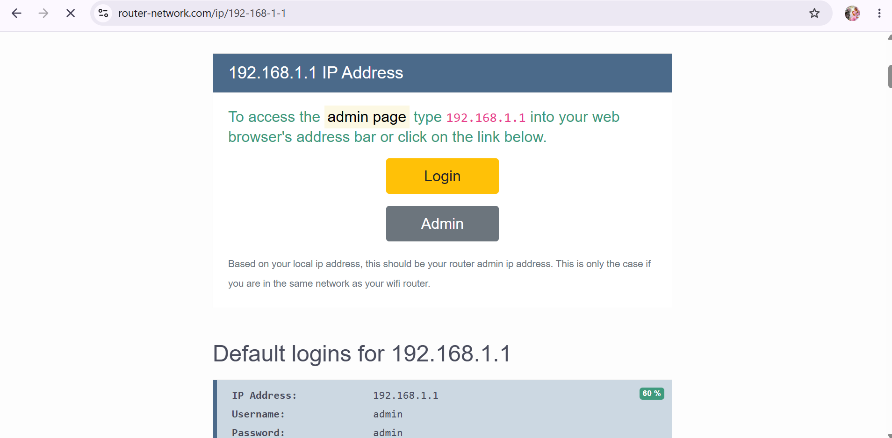
A Screenshot Of The Login Page.

Slide 2
the current IP address, subnet mask, and default gateway assigned:
Connection-specific DNS Suffix . :
IPv6 Address.:2401:4900:88b7:19ad:ab4e:5aa2:9df0:6907
Temporary IPv6 Address.:2401:4900:88b7:19ad:896:15e4:5d72:c28b
Link-local IPv6 Address . . . . . : fe80::aba6:cc50:2ffa:d05e%16
IPv4 Address : 192.168.1.7
Subnet Mask : 255.255.255.0
Default Gateway : fe80::3215:77ff:fe4b:9e64%16
192.168.1.1

Slide 3
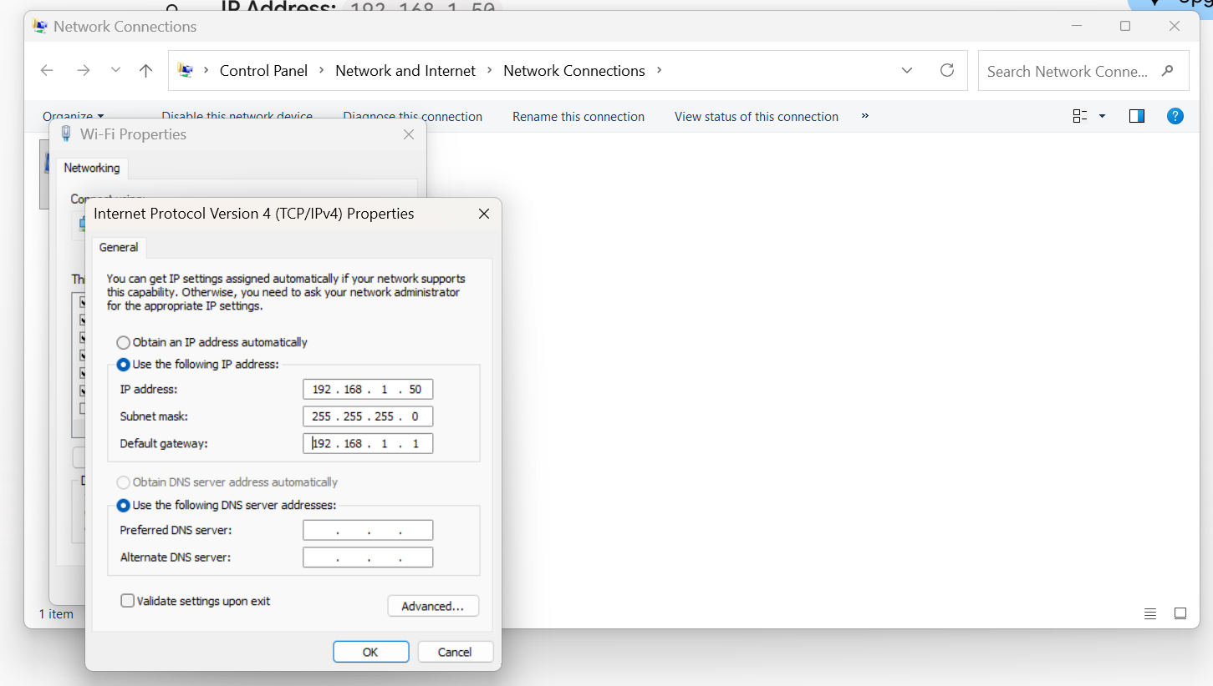
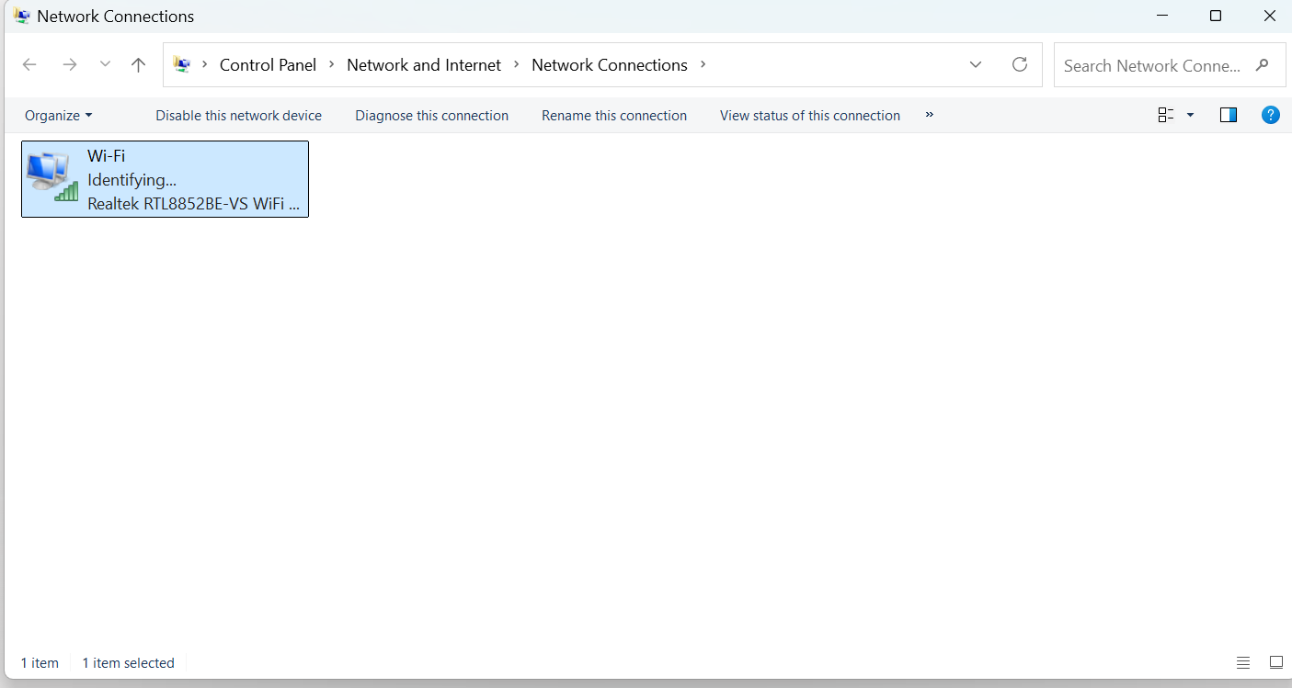
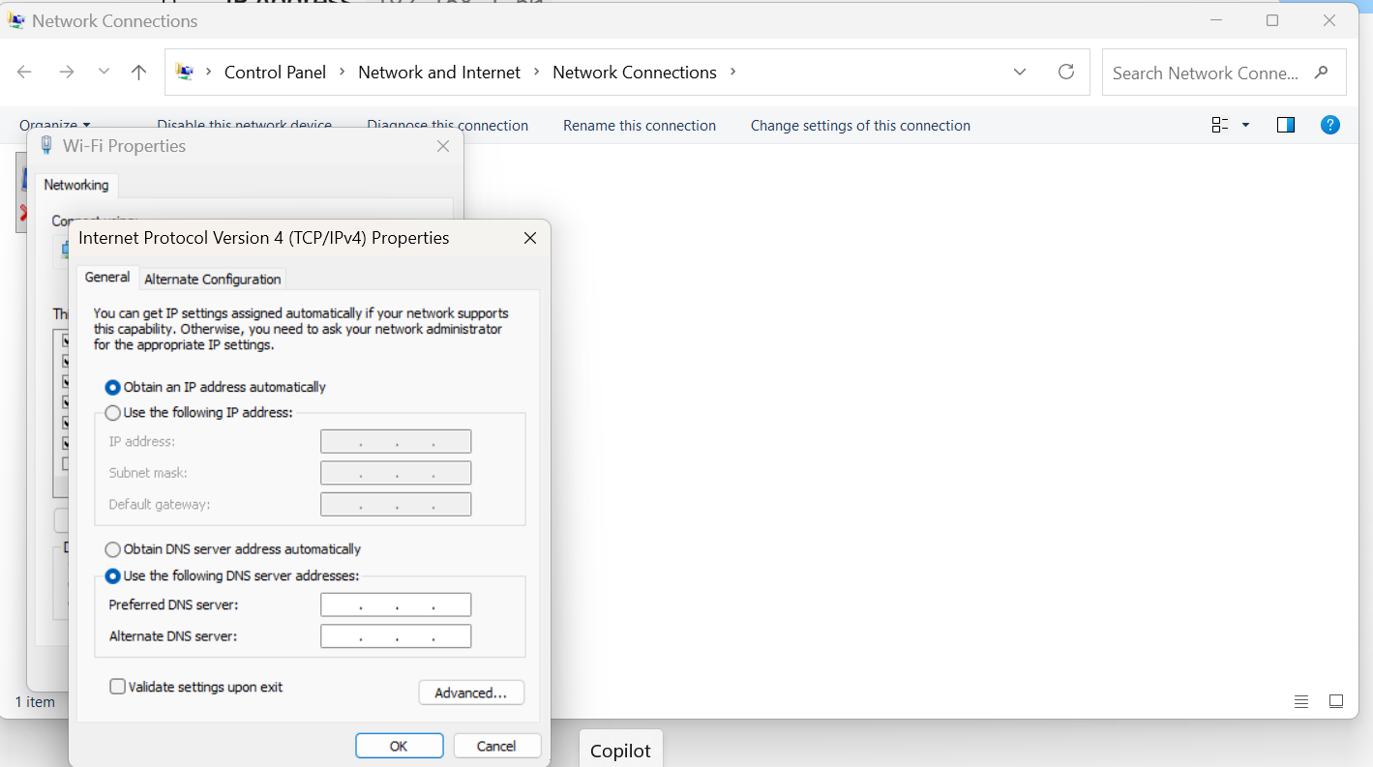
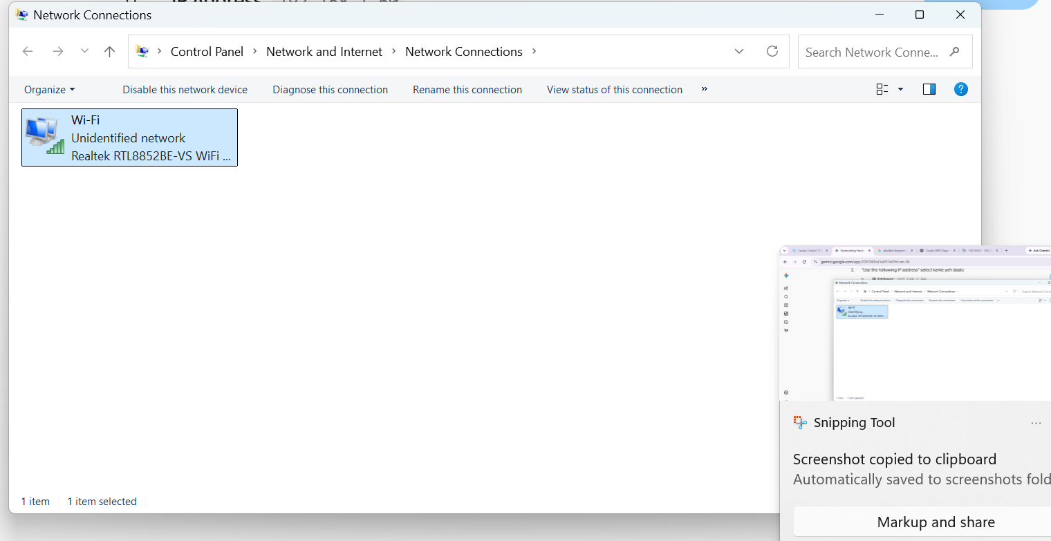
Static IP Set

Slide 4

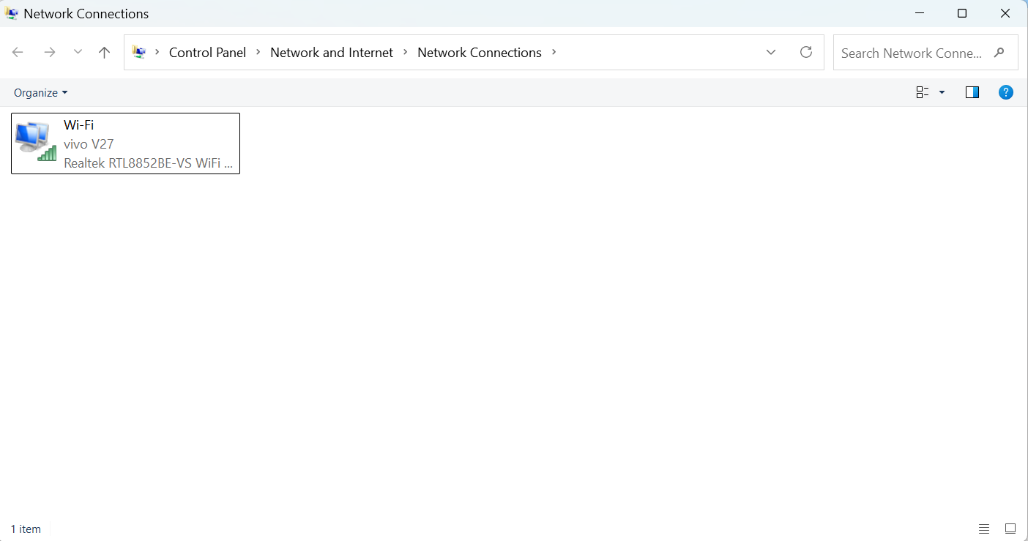

Slide 5
Current DHCP Range: 192.168.1.100 to 192.168.1.200 (This is the standard default DHCP pool range configured in most home Wi-Fi routers under the LAN / DHCP Server settings).
Explanation of IP Conflict: If two devices on the same network are assigned the exact same IP address, an IP Address Conflict occurs. This confuses the router regarding which device should receive incoming data packets, causing frequent network drops, connection instability, or a complete loss of internet access for both affected devices.

